Slide 1
Business report of HBFC bank

Slide 2
Task1 Bank’s customers who have availed Personal Loans
Approach used: I have used pivot table to aggregate customers who have availed personal loan.
Step 1: Select entire table range. Click the insert ribbon. Click pivot table. Click new location.
Step 2: Add personal loan field to rows in pivot table field. Add ID to values. Click value field setting and change it to count.
Inference: 10% of the customers only availed personal loan from the bank.
Output:

Slide 3
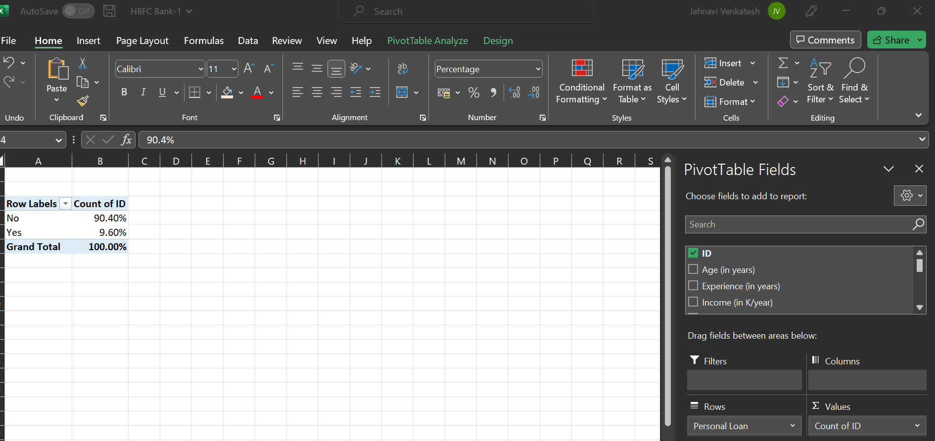

Slide 4
Task 2: A table with min, max, median & average for all numeric variables (age, experience, income, family members, CCAvg, Mortgage).
Approach used: I have created a table with max, min, median and average in column. And numeric variables in rows and used the formula =MAX(Bank_Personal_Loan_Modelling!B:B) to find the maximum values, =MIN(Bank_Personal_Loan_Modelling!B:B) to find minimum values, =MEDIAN(Bank_Personal_Loan_Modelling!B:B) to find median and =AVERAGE(Bank_Personal_Loan_Modelling!B:B) to find average value for the age variable. Similarly I filled for all the other variables
Insights: From the pivot table we can clearly see, as the age increase, the experience, income, CCAvg and mortgage gradually and simultaneously gets increased.

Slide 5
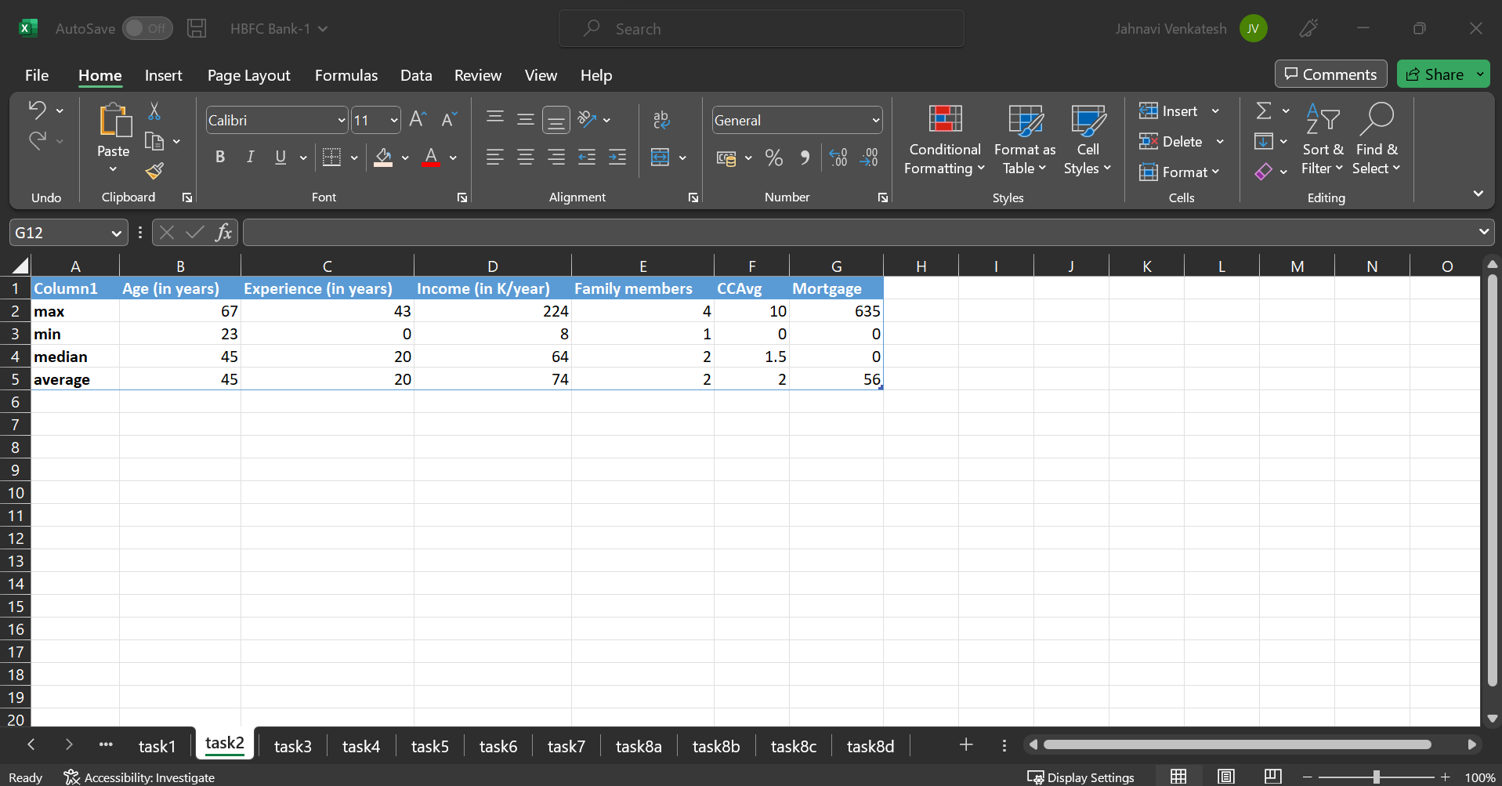
Output:

Slide 6
Task 3: To create a new categorical variable for Experience
Approach used:
Step 1: The experience field is added to a new worksheet and used nested if function to create experience range
Formula used: =IF(A2<=10,"0-10 years",IF(A2<=20,"11-20 years", IF(A2<=30,"21-30 years","30+ years")))
Step 2: A bar chart is plotted using pivot table, where experience range is added to rows and values then it is changed to count in the values.
Step 3: Insert – pivot chart – bar chart
Insights: From this it is clear that, customers in the experience range 21-30 were slightly higher than customers in 11-20 and 0-10 experience range. Where customers with 30+ years of experience is comparatively low.
:

Slide 7
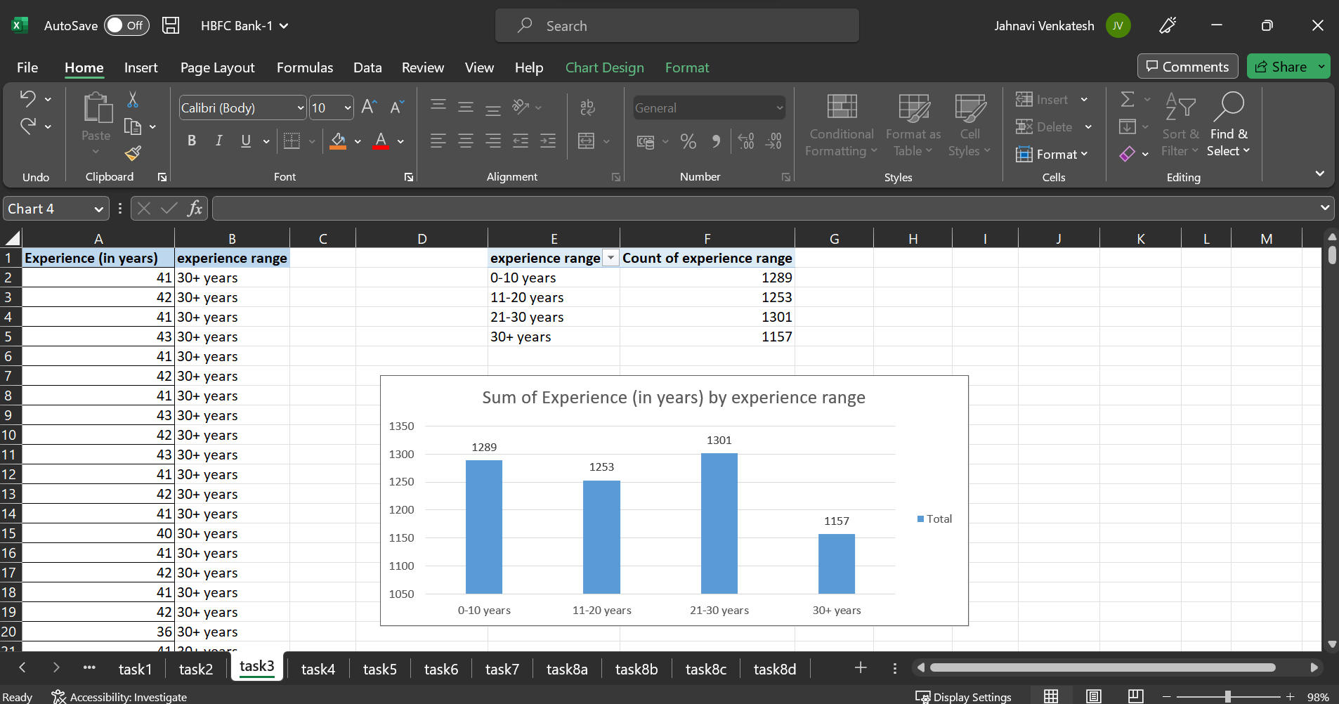
Output:

Slide 8
.
Task 4:
A scatter plot of the Age and the Experience variable
Approach used: Age and experience columns are copied and pasted in a new worksheet. The two columns are selected – insert – scatter chart. A scatter chart is created.
Insights: A scatter plot is used to show the relationship between the variables. From this chart we can clearly see age increase, experience also increase simultaneously. Age and experience are positively correlated.
Output:

Slide 9
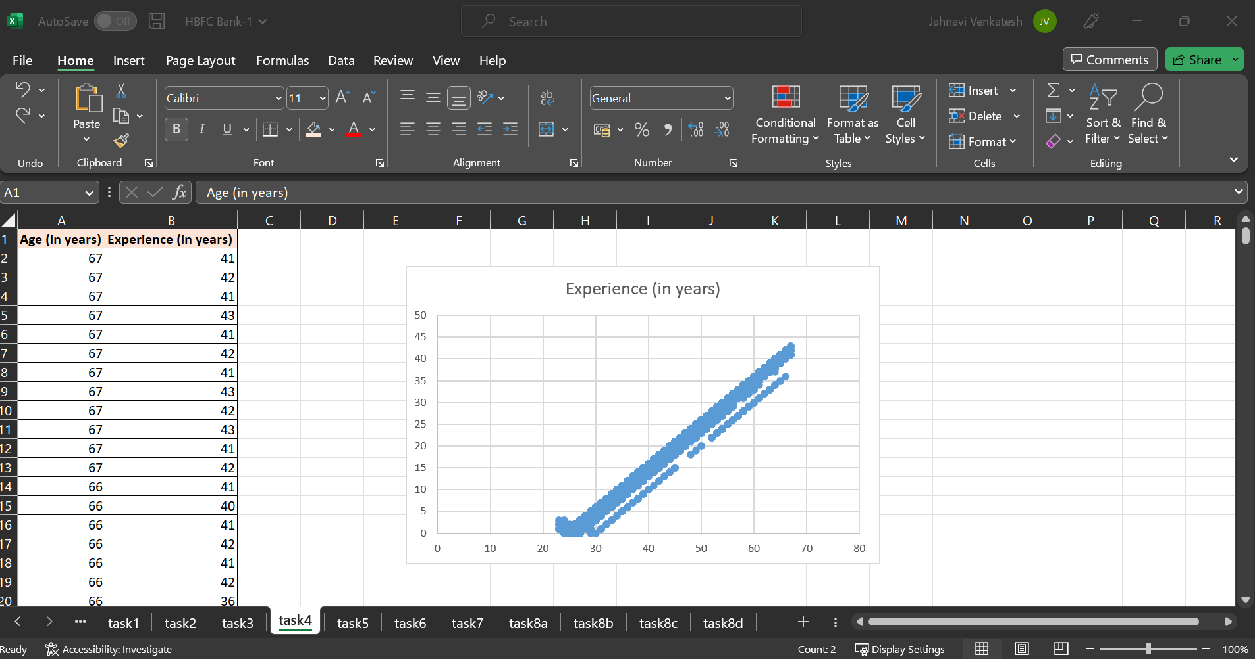

Slide 10
Task 5:
The top 3 areas (ZIP Codes) where the bank’s customers are located.
Approach used:
Step 1: Select entire range – insert – pivot table – new worksheet – zip code to rows – id to columns – in value field setting of columns changed sum to count of id.
Step 2: Right click on count of zip code and sorted to largest to smallest.
Step 3: Using rank function rank of the count of id is calculated
Formula used: =RANK(C3,$C$3:$C$469)
Step 4: From this the top 3 values are copied and pasted separately.
Insights used: The areas(zip codes) 94720, 94305 and 95616 having the highest customer counts 169, 127 and 116.

Slide 11
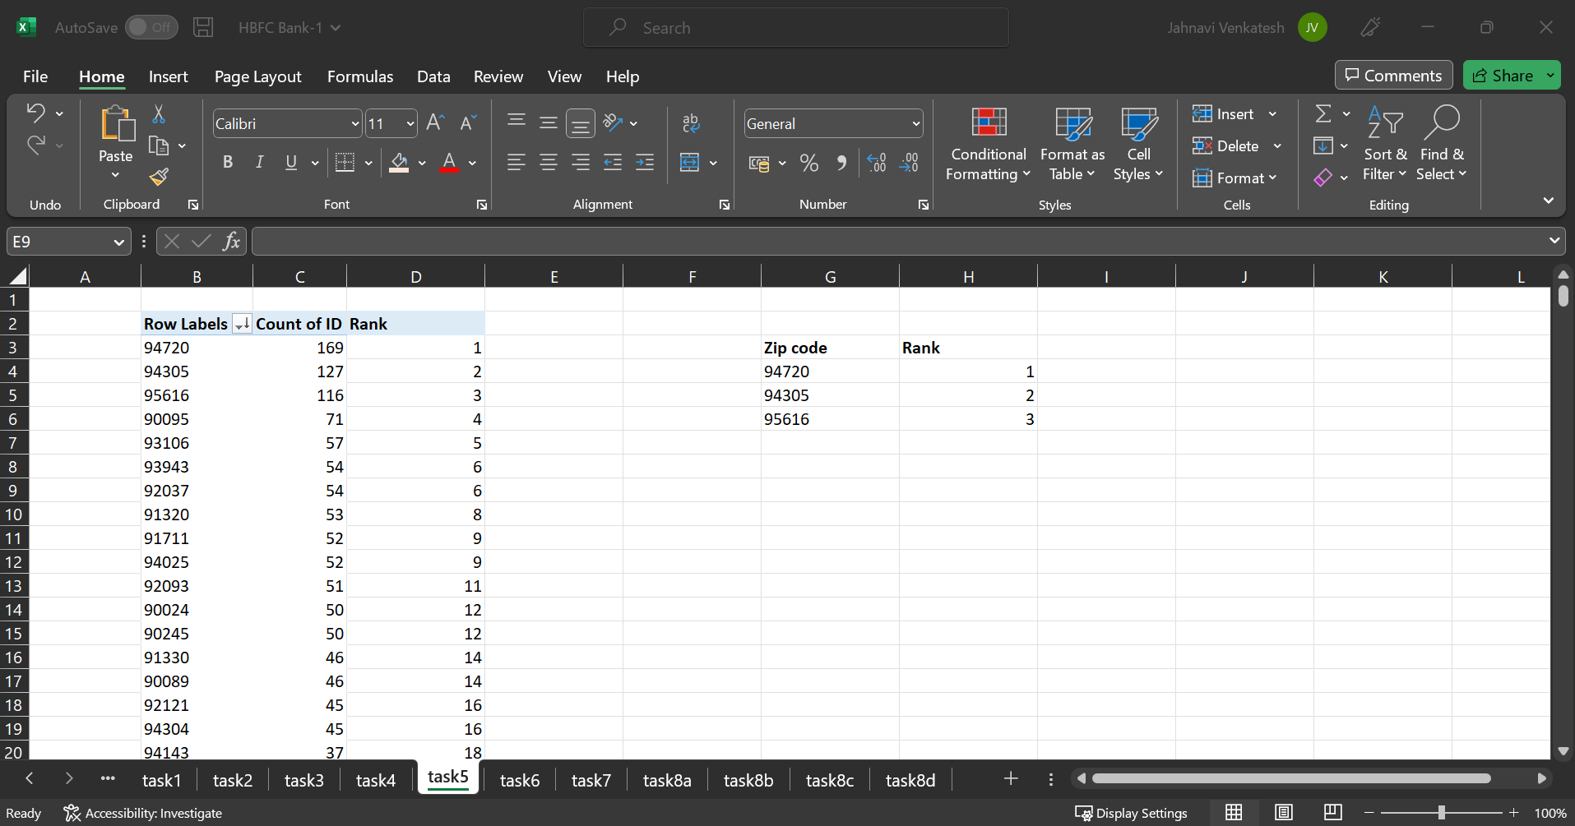
Output:

Slide 12
Task 6:
Customers who have fixed deposit, current deposit but not personal deposit
Approach used: Using pivot table. Personal deposit, current deposit and fixed deposit are added in the filter field. Id is placed in values and changed it to count. Keeping the personal deposit to no and fixed deposit, current deposit to yes.
Insights: This shows the count of customers who have availed for fixed deposit and current deposit but not personal deposit. Only 147 customers have availed for this. This shows that the bank has to increase the campaign in order to make the customers avail for the loans based on their requirement and need.
Output:

Slide 13
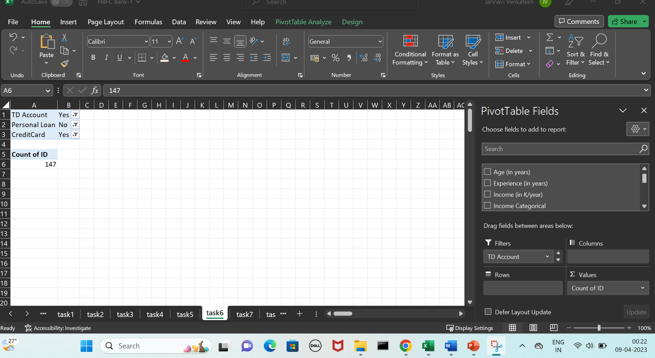
Output:

Slide 14
Task 7:
The median income of the customers who have availed personal loans and compare it with the median income of those customers who have not availed personal loans.
Approach used: Using filter, filter the personal loan column and select yes. Now the personal loan field and income of the customers are copied and pasted in a new worksheet. Then the median of the sorted customer income is found. Same is repeated, after filtering the personal loan column to no.
Insights: From the median of the income of customers who have availed for personal loans with the ones who haven’t it shows that the customers who have availed for the loans tend to earn 2.5 times more than the others. So this can be used in the campaign to let the people know which helps for the betterment of the bank.

Slide 15
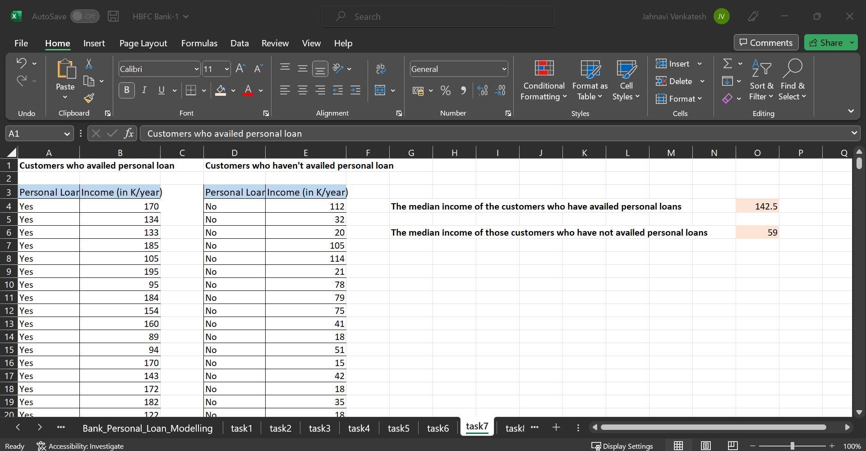
Output:

Slide 16
Task 8:
4 separate Pivot Tables for Education vs Personal Loan, TD Account Vs Personal Loan, Online vs Personal Loan, Income_Category vs Personal Loan
Approach used: Create pivot table – personal loan for every pivot table is added in both values and columns. Value is changed to percentage in the value field. And the remaining variable is added in the row field. Similarly four pivot tables are created.
Insights:
In Education vs personal loan, from the percentage of customers, the customers who are graduated, professionals and undergraduate do not avail much for personal loan when compared the ones who are uneducated.
In TD Account vs Personal Account, the combination of customers who are not availed for both the loans are very high whereas the combination of customers are availed for both is very low.

Slide 17
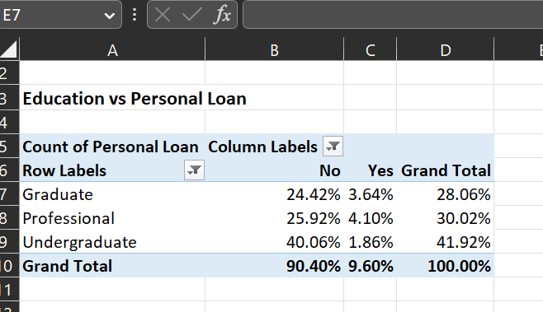
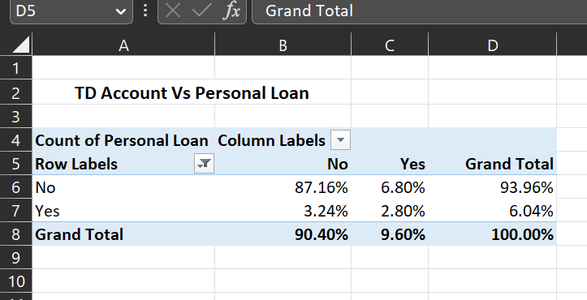
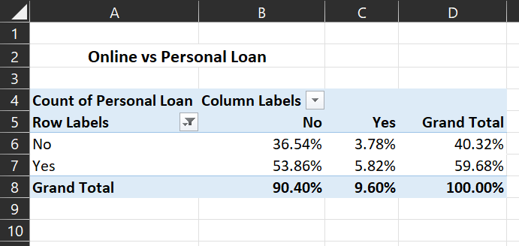
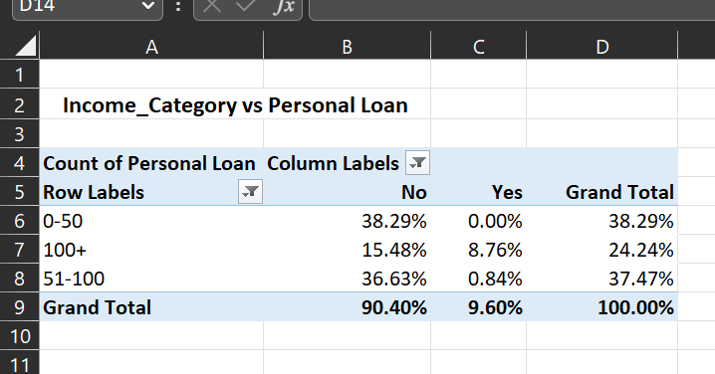
Output:

Slide 18
Task 9:
Based on the pivot tables provided, there are a few observations:
In the "Education vs Personal Loan" pivot table, the percentage of personal loan uptake is the highest among customers who are Undergraduates (41.92%) and lowest among those who are Graduates (28.06%). As one might expect that customers with higher levels of education might have higher incomes and be more likely to take out personal loans. This could be anomaly.
In the "TD Account vs Personal Loan" pivot table, the majority of customers (93.96%) do not have a personal loan, while only a small percentage (6.04%) do. This is not necessarily anomalous, as it is common for a relatively small percentage of customers to take out loans in any given period.
In the "Online vs Personal Loan" pivot table, a higher percentage of customers who use online banking (59.68%) have taken out a personal loan compared to those who do not use online banking (40.32%).
In the "Income Category vs Personal Loan" pivot table, the percentage of personal loan uptake is highest among customers with incomes in the 51-100 range (37.46%) and lowest among those with incomes over 100 (24.24%). One might expect that customers with higher incomes might be more likely to take out personal loans. This could also be an anomaly.
Overall, it appears that the "Education" and "Online Banking Usage" categorical variables may be the most important for further study in analysing which customers are most likely to take personal loans.

Slide 19
Task 10:
To save money in the marketing campaign, the HBFC bank should find the customers who are most likely to take a personal loan offer. They can use data and analytics to figure out which customers are more likely to accept the offer based on things like income, credit history, and past purchases. Then, they can focus their outreach efforts only on those customers, which will save them money. They can also create different messages for different customer groups to make the offers more appealing.

Slide 20
The End

